Slide 1
Continuous Monitoring
SE489: DevOps Engineering

Slide 2
Outline
Monitoring in DevOps
Why we need Continuous Monitoring?
What is Continuous Monitoring?
Continuous Monitoring Use Cases
Continuous Monitoring Tools
What is Nagios?
Case Studies

Slide 3
Monitoring in DevOps

Slide 4
What is DevOps Monitoring?
DevOps monitoring entails overseeing the entire development process from planning, development, integration and testing, deployment, and operations.
It involves a complete and real-time view of the status of applications, services, and infrastructure in the production environment.
Features such as real-time streaming, historical replay, and visualizations are critical components of application and service monitoring.

Slide 5
What is DevOps Monitoring?
DevOps monitoring allows teams to respond to any degradation in the customer experience, quickly and automatically.
More importantly, it allows teams to “shift left” to earlier stages in development and minimize broken production changes.
An example is better instrumentation of software to detect and respond to errors, both manually through on-call and also automatically whenever possible.

Slide 6
Monitoring in DevOps
Monitoring provides feedback from production.
Monitoring delivers information about an application's performance and usage patterns.
Is monitoring all about?
Monitoring the live application
How about, monitoring followings
Planning, Development, Integration and Testing, Deployment, and Operations
Continuous Monitoring
a.k.a. ConMon

Slide 7
Monitoring in DevOps
Continuous monitoring in DevOps has a few specific goals, as are mentioned below:
Continuous monitoring aims to strengthen the transparency of such environments while keeping in place a vigilant system to monitor and resolve said issues.
Continuous monitoring aims to identify performance inconsistencies and error sources. It also resolves these problems using relevant solutions to safeguard the enterprise.
Continuous monitoring assists companies in keeping a tab of their user experience. CM is especially helpful in tracking user feedback after a recent change or update to a software or an application. This helps firms build and strengthen their business strategies.

Slide 8
Monitoring Goals
Achieve high availability
Reduce time to detect (TTD)
Reduce time to mitigate (TTM)
Reduce time to remediate (TTR)
Real-time feedback
On the overall health of IT infrastructure
Application performance issues
Visibility and transparency of network activity
Monitor user behavior and feedback
Experience with new updates

Slide 9
Importance of DevOps Monitoring
Visibility
E.g. Team members need to see all events when a failure occur
Automated Collaboration
All team members should get the notification to events (merge request, commits, merge, etc.) automatically
E.g. Git or Gitlab Slack or Webex notification
Push
Issues
Merge Requests
Comments
Pipeline
Deployment
Code quality, Test report, Code coverage, etc…
Mitigate the risk of cyber attacks
With real-time alert system

Slide 10
Importance of DevOps Monitoring
Change management
Quickly see the changes that cause application outage
Monitoring dependencies
You are using latest version of a external tools
There is an update in the third party tools and
Monitor if that third party tool itself is not vulnerable
Monitoring external tools/services

Slide 11
Why we need Continuous Monitoring?

Slide 12
Why we need Continuous Monitoring?
Failure of CI/CD Pipelines
Application Issues
Infrastructure Issues
Static Code Analysis

Slide 13
Why we need Continuous Monitoring?
Issues with CI/CD Pipelines:
Rapid introduction of performance problems and errors
Rapid introduction of new endpoints causing monitoring issues
Lengthy root cause analysis as the number of services expands

Slide 14
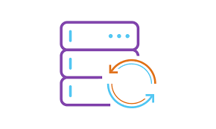
Why we need Continuous Monitoring?
</>
Running APM solutions earlier in lifecycle
Production-like Environment
Feedback of how application will perform in production
Taking corrective actions

Slide 15
Why we need Continuous Monitoring?
Server health cannot be compromised at any cost
Increase response time

Slide 16
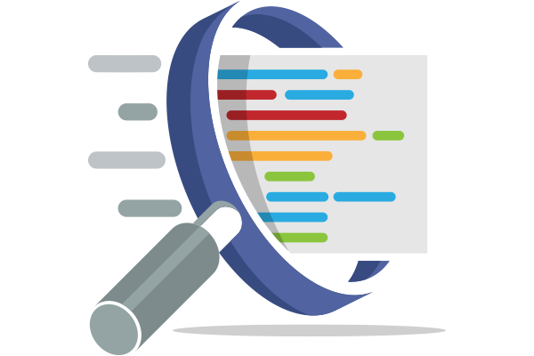
Why we need Continuous Monitoring?
Static code analysis will give insights about your code

Slide 17
What is Continuous Monitoring?

Slide 18
What is Continuous Monitoring?
Effective comprehensive monitoring approach is essential for visibility of your application and Infrastructure

Slide 19
What is Continuous Monitoring?
Continuous Monitoring (CM), is an automated process by which DevOps personnel can observe and detect compliance issues and security threats during each phase of the DevOps pipeline.
Once the software is released into production, Continuous Monitoring will notify dev and QA teams in the event of specific issues arising in the prod environment.
It provides feedback on what is going wrong, which allows the relevant people to work on necessary fixes as soon as possible.
It assists IT organizations, DevOps teams in particular, with procuring real-time data from public and hybrid environments.

Slide 20
What is Continuous Monitoring?
Continuous monitoring is the process of identifying threats to the security and compliance rules of a software development cycle and architecture.
Helps business and technical teams determine and interpret analytics to solve crucial issues
Help enterprises acquire data from various ecosystems
It is a fully automated procedure

Slide 21
Continuous Monitoring Aim
Strengthen the transparency of the ecosystem
Monitor and resolve issues
Identify and resolve performance inconsistencies and error sources
Assist companies in keeping a tab of their user experience

Slide 22
Monitor vs Alert
Monitoring has become an umbrella term whose meaning strongly depends on the context.
Most broadly, it refers to the process of becoming aware of the state of a system. This is done in two ways, proactive and reactive.
The former involves watching visual indicators, such as timeseries and dashboards, and is sometimes what administrators mean by monitoring.
The latter involves automated ways to deliver notifications to operators in order to bring to their attention a grave change in system’s state; this is usually referred to as alerting.

Slide 23
Types of Continuous Monitoring
Infrastructure Monitoring
Nagios and Prometheus
Application Monitoring
Datadog and Splunk
Network Monitoring
Wireshark and NMap

Slide 24
Infrastructure Monitoring
Containers, VMs, Physical machines/servers
Resource utilization
Software
Storage servers
Cluster performance

Slide 25
Application Monitoring
Uptime
Transaction time and volume
System responses, throughputs, error rate
API responses
Front-end and back-end
Page load time
# of HTTP requests, request rate, HTTP request execution time, etc.

Slide 26
Network Monitoring
Network traffic, bandwidth, packet flows
Firewalls, Gateways, VPNs, security groups
Network interfaces, IPs
Endpoints,
Load balancers, latency
SSH, pings, connections, etc…

Slide 27
User behavior
Usually tradition monitoring are not that useful for this category
How users are using your application ?
Overall customer experience
Usage of application
Application specific data
YouTube, CuriosityStream, Vimeo, etc.
Financial applications
Education application
Ecommerce application
Social networking applications

Slide 28
Benefits of Continuous Monitoring
Better security
Automate many security measures.
Performance errors are detected earlier
Help determine performance inconsistencies
System downtime is significantly reduced
Keep a vigilant eye on the database, network, and applications, helping to resolve any issues before they give rise to system downtime
Facilitates better performance for the business
By alleviating system downtimes, it improves user experience and business credibility

Slide 29
Continuous Monitoring Phases - NIST

Slide 30
Continuous Monitoring Phases - Patriot

Slide 31
Best Practices for Continuous Monitoring in DevOps
Decide what to monitor: Different organizations need to monitor different aspects of their IT landscape. Primarily, the targets are categorized into the following:
Server status and health
Application performance log
System vulnerabilities
Development milestones
User activity/behavior
As far as possible, try to track parameters belonging to each category.

Slide 32
Continuous Monitoring Use Cases

Slide 33
DevOps monitoring use cases
Detect and report errors earlier.
Flagging issues to DevOps teams more quickly means they can resolve them before they impact user experience.
Reduce system downtime.
DevOps monitoring tools allow tech teams to have continuous oversight of the database, applications and networks so they’re able to resolve any issues before system downtimes occur.

Slide 34
DevOps monitoring use cases
Increase security.
Through data analysis across the entire ecosystem, continuous monitoring in DevOps automates security measures by identifying inconsistencies or triggers that lead to security failures. Teams can then respond to threats manually (on-call) or automatically with tools.
Enhance observability of DevOps components.
Easily identify when various systems and applications in your DevOps stack degrade in performance, cost, security or other factors to avoid problems down the road.

Slide 35
DevOps monitoring use cases
Uncover root cause of issues faster.
Continuous tracking of logs and metrics can help teams to identify the root cause — where a problem started or occurred. This allows engineers to identify patterns in system behavior to look out for in future. It also leads to improvement of mean time to detection (MTTD), mean time to repair (MTTR), and mean time to isolate (MTTI).
Improve collaboration.
The establishment of a continuous feedback loop improves collaboration between the DevOps teams and engineers, the rest of the enterprise and both internal and external users.

Slide 36
DevOps monitoring use cases
Enhance the user experience.
DevOps monitoring continuously tracks user feedback which can help inform new updates or changes to the app or system.
Boost business credibility.
All the functions above help to ensure that an enterprise can be more in tune with its product and is able to improve it using customer and employee feedback — all with limited time, cost and effort.

Slide 37
Continuous Monitoring Tools

Slide 38
Monitoring tool features
Real-time streaming and alert
On critical components of application and services
On hardware, application, operation
Configurable alert
Query health status
Automatic reporting
Automated log aggregation
Data analytics
Historical replay
Visualizations
Use of REST APIs

Slide 39
Push vs Pull mechanism
Metrics are periodically sent by each monitored system to a central collector
Central collector periodically
requests metrics from each
monitored system

Slide 40
Push vs Pull mechanism
Features
Discovery:
Push: No need to configure collector, agent just need to be ready to push the metrics
Pull: you need to configure and reload the collector periodically
•Scalability:
Push: Fully distributed
Pull: More centralized
Security
Against remote attack

Slide 41
Push vs Pull mechanism
Features
Latency
Push: what happen when 1000 systems push metrics to single collector?
Pull: single collector need to make 1000 requests to get the updated information
Complexity
Complexity for Agent
What happen when there large number of agents?
Complexity of Collector
Flexibility
Push: pre-determined metrics are pushed
Pull: can get any metric at any time from any monitored system

Slide 42
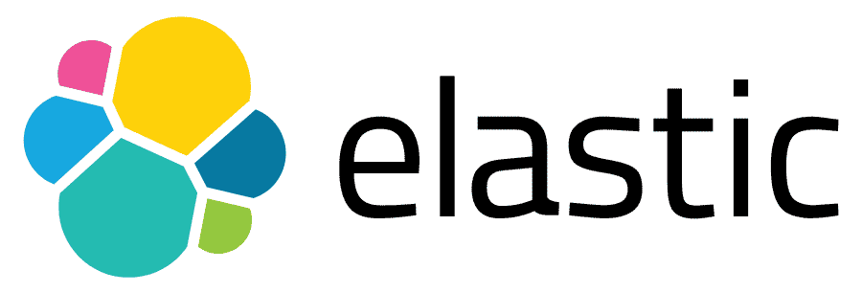
Continuous Monitoring Tools

Slide 43
What is Nagios?

Slide 44
What is Nagios?
Nagios monitors your entire IT infrastructure to ensure systems, applications, services, and business processes are functioning properly.

Slide 45
Nagios Features

Slide 46
Nagios Architecture
Nagios is built on server/agents architecture
Nagios server is running on a host, and plugins interact with local and remote nodes
Plugins will send information to the Scheduler

Slide 47
Nagios Dashboard

Slide 48
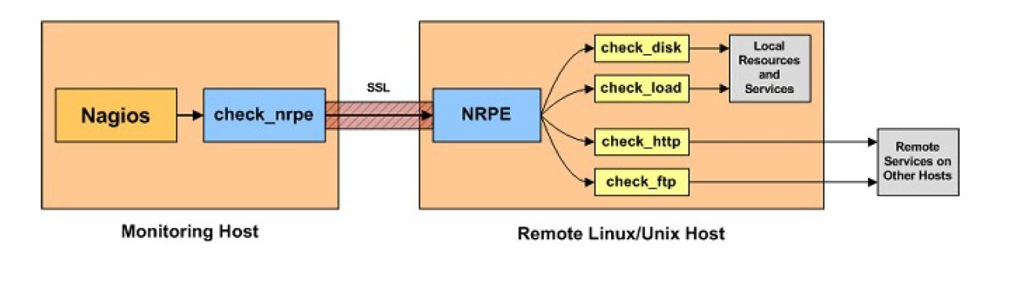
Monitoring Remote Linux Hosts

Slide 49
Case Studies

Slide 50
Nagios Case Study - Bitnetix
Bitnetix was tasked with monitoring an online store for an e-commerce retailer with a billion dollar annual revenue.
Beyond keeping the lights on for the store, Bitnetix needed to ensure:
The cart and checkout functionality was up and running
Cehck fro website defamation, and notify yhe necessary staff if anything went away

Slide 51
Challenge
Bitnetix hit a roadblock upon realizing that the client's data center was located in Seacacus, New Jersey, more than 500 miles away from their staff in Rochester, NY
Dev
Test
Prod

Slide 52
Challenge
Bitnetix hit a roadblock upon realizing that the client's data center was located in Seacacus, New Jersey, more than 500 miles away from their staff in Rochester, NY
Most of the notifications sent to the client were ignored because there were so many false positives

Slide 53
Solution

Slide 54
Results

Slide 55
Nagios Case Study - Tier 4 certified data center
Client Details:
The client is India’s first Tier 4 certified data center providing a penalty backed SLA of 99.995% uptime.
Silicon India has acknowledged the client as one of the Top 25 Cloud Computing companies in India based on economy, usability and flexibility.
It is the Cloud Providers in India offers Private Cloud on Demand, Cloud hosting and cloud servers hosting solutions.

Slide 56
Nagios Case Study - Tier 4 certified data center
Problems Faced :
The client wanted a tool which can provide graphical resource utilization with time flexibility on (weekly or monthly basis)
They were in need of top 10 alerts in graphical mode.

Slide 57
Nagios Case Study - Tier 4 certified data center
Solutions Offered:
The client installed Nagios Core already & was looking for an upgrade.
Installed Nagios XI to provide graphical resource utilization updates on weekly or monthly basis with top 10 alerts.

Slide 58
Nagios Case Study - Tier 4 certified data center
Goals Achieved:
They have reached client's expectations by providing graphical resource utilization as per their requirement.
The client is now able to manage network effectively with top 10 alerts.

Slide 59
Nagios Case Study - Tier 4 certified data center
Results Obtained:
Graphical resource utilization.
Weekly or monthly reports.
Top 10 alerts in graphs.
Nagios XI advanced features.
Monitor with updated web UI.
Central view of IT ops n/w

Slide 60
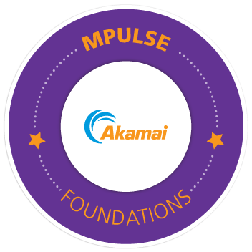
Akamai MPulse
Akamai MPulse collects and analyses behavior data and experiences of users visiting the application or website.
It can capture performance metrics and real-time user activities from each user session by adding a snippet to the page it needs to analyze.

Slide 61
AppDynamics
AppDynamics is one of the most popular application performance monitoring tools available in the market.
As a continuous monitoring tool, AppDynamics helps monitor your end users, applications, SAP, network, database, and infrastructure of both cloud and on-premises computing environments.
With this tool, your DevOps team can easily gain complete visibility across servers, networks, containers, infrastructure components, applications, end-user sessions, and database transactions, so they can swiftly respond to performance issues.

Slide 62
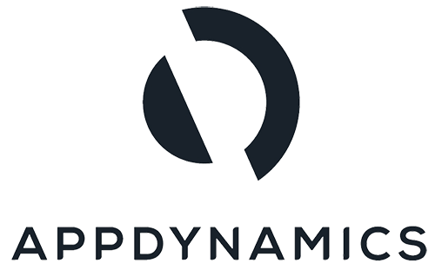
AppDynamics
Some of the key features of the AppDynamics tool are:
The tool seamlessly integrates with the world’s best technologies such as AWS, Azure, Google Cloud, IBM, and Kubernetes
AppDynamics leverages machine learning to deliver instant root-cause diagnostics
The tool supports hybrid environment monitoring
Cisco full-stack observability with AppDynamics
The tool comes with a pay-per-use pricing model

Slide 63
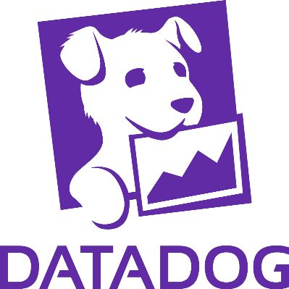
Simplified Monitoring Case Study
How Simplified Monitoring Helped Fundbox Build a DevOps Culture?
Fundbox needed a single monitoring platform to bolster its DevOps efforts and reduce maintenance overhead.
With Datadog, it consolidated eight monitoring tools into one, leading to heightened collaboration, improved efficiency, and faster resolutions.

Slide 64
Simplified Monitoring Case Study
Fundbox is an AI-powered financial services platform that offers fast and intuitive access to business credit.
Backed by an R&D team of over 100 engineers, Fundbox’s platform is completely cloud-native, with its component microservices hosted on AWS.

Slide 65
Simplified Monitoring Case Study
Fundbox is an AI-powered fintech startup that offers credit and payment solutions to help small businesses meet their working capital needs.
Having already connected with over 325,000 businesses since its founding in 2013, the company has gained popularity thanks to its fast and reliable customer experience.
In 2020, Fundbox looked to build on its success by seeking ways to strengthen its DevOps processes. Through a cross-team initiative, the company uncovered a key obstacle it had been facing in DevOps: Engineers were using eight different systems to monitor the hundreds of microservices that made up the Fundbox platform.

Slide 66
Simplified Monitoring Case Study
The complexity of the Fundbox monitoring infrastructure made it hard for DevOps engineers to quickly spot and resolve issues in production.
And a few of these individual monitoring tools required extensive DIY customizations and ongoing maintenance.
All this extra overhead reduced the time available for engineers to perform core DevOps functions, such as updating Fundbox services.
Fundbox wanted to empower its engineers to quickly find and fix issues on their own.
And it wanted to reduce the overhead associated with maintaining its monitoring infrastructure, so that DevOps teams could concentrate instead on innovating and iterating.

Slide 67
Simplified Monitoring Case Study
The Environments team, led by Tal Turgeman, knew that a single, all-inclusive monitoring system was crucial to solving these problems.
“We don’t want engineers and ops to focus on creating a monitoring system when we should focus on creating new products, making the CI/CD faster, and making production more robust and scalable.”
Fundbox ultimately chose Datadog for its ability to give a holistic view across infrastructure, applications, logs, networks, platform availability, external cloud-based services, and databases.
Only a platform like Datadog that offered complete visibility could meet Fundbox’s goals of strengthening DevOps collaboration and reducing issue resolution times and can help us from reactive to proactive

Slide 68
Simplified Monitoring Case Study
Key Results
8 Systems → 1
Fundbox lowered maintenance overhead
Simplified learning requirements by reducing eight separate monitoring tools to a single, unified platform.
Faster Resolutions
Out-of-the-box integrations and accurate alerting gave Fundbox the tools to detect issues more easily and form correlations across services.
Improved DevOps Collaboration
Datadog’s intuitive user interface led to collaboration across teams.

Slide 69
Simplified Monitoring Case Study
Challenge
Fundbox sought to enhance its DevOps processes by boosting responsiveness to software issues and reducing time spent maintaining its many monitoring tools.
The company wanted one holistic solution that could empower developers to quickly spot and fix issues without being weighed down by so many monitoring systems.
Why Datadog?
Datadog gave Fundbox’s DevOps team a single source of truth for monitoring across infrastructure, application performance, and logs.
Teams now receive accurate alerts when production issues occur and can work together to investigate and resolve issues faster.

Slide 70
Highly Available and Scalable Platform
Learn how Datadog enabled Braze’s customer-facing teams to shorten time spent resolving incidents and accelerate customer communication
Braze is an American cloud-based company that develops customer relationship management software to help businesses with multichannel marketing.
Its software is used by 2.5 billion users and processes approximately 1.5 billion messages per month.

Slide 71
Highly Available and Scalable Platform
On a daily basis, Braze processes more than 8 billion API requests and sends more than 2.7 billion daily messages to a network of over 2.4 billion monthly active users.
Jamie Doheny, Chief of Staff for Braze’s engineering organization, notes, “We needed a solution that helped us overcome the challenge of scaling our organization, including debugging incidents, and rapidly resolving customer support tickets.”
To put this in perspective, Braze grew its employee headcount by 57% in 2019, ending the year with almost 500 employees.
The company also has more than 900 customers and is one of the few companies that continues to grow its employee headcount and customer base despite the pandemic.

Slide 72
Highly Available and Scalable Platform
In order to maintain performance at this scale, the team needed to find a way to handle all this traffic and inbound customer requests.
Scaling observability:
With a growing engineering organization, teams had different techniques and tools for evaluating the performance of their applications and scaling their systems.
Enabling customer support:
Historically, many technical customer support tickets were escalated directly to the Product and DevOps engineering teams, effectively bypassing the Global Services and Support team when the questions were about performance, uptime, or throughput.

Slide 73
Highly Available and Scalable Platform
Solution: A unified observability platform
Braze was looking to find a unified observability platform to deploy throughout the organization.
By adopting one observability platform, Braze could standardize their engineering team’s scaling process and enable the support team to solve most customer tickets.
Braze chose to deploy Datadog and saw the platform as the path to achieving maximum observability, delivering a stellar user experience and establishing the proper processes to confidently scale.
Datadog is accessible to users of all technical levels—without the need for extensive onboarding or specialized query languages.

Slide 74
Highly Available and Scalable Platform
Business outcomes
Establishing processes to address scaling challenges
Providing data and information to improve customer support
Key Results
90% Reduction in processing time on Braze's email rendering service.
1 solution
All eight product teams can now use a single, unified monitoring platform with Datadog

Slide 75
Highly Available and Scalable Platform
Challenge
The teams at Braze had multiple tools for evaluating application performance and scaling their systems.
Many of these tools were not effective; for instance, tickets submitted to the technical customer support team were often escalated directly to the Product and DevOps engineering teams, which led to an increase in MTTR and impacted customer experience.
“ Over the past few years, Braze has built a best-in-class customer engagement platform that is used by the world’s leading brands. As a company, we will continue scaling our platform and expanding our organization to support rapidly increasing market demand, which presents new and exciting challenges. Datadog has enabled us to rally around one platform that will help us scale over the near and long-term.”
Jamie Doheny Chief Of Staff, Braze

